Slide 1
Lecture 3
Simpson Rule

Slide 2











Introduction
The Simpson 1/3 rule is the closed three point Newton-Cote formula
$$y$$
$$y=f(x)$$
$$y=P_{2}(x)$$
$$I=\int_{a}^{b}{f(x)dx}$$
$$I≅\int_{a}^{b}{P_{2}(x)dx}$$
$$x_{1}=\frac{a+b}{2}$$
$$x$$
$$a$$
$$=x_{o}$$
$$b$$
$$=x_{2}$$
Notes:
In this lecture we discuss a second quadrature formula: the closed three point Newton-Cote formula
This quadrature formula is as well known as the Simpson 1/3 rule
In the three point Newton-Cote formula we interpolate the function f to integrate in the three points: the start, mid and end point of the integration interval.
The resulting interpolation polynomial P2(x) is the parabola passing by these points.
The approximation of the defined integral over f(x) will be the surface below the interpolating polynomial P2(x).
Contrary to the trapezoid rule we cannot give right away the value of the surface below P2(x)

Slide 3
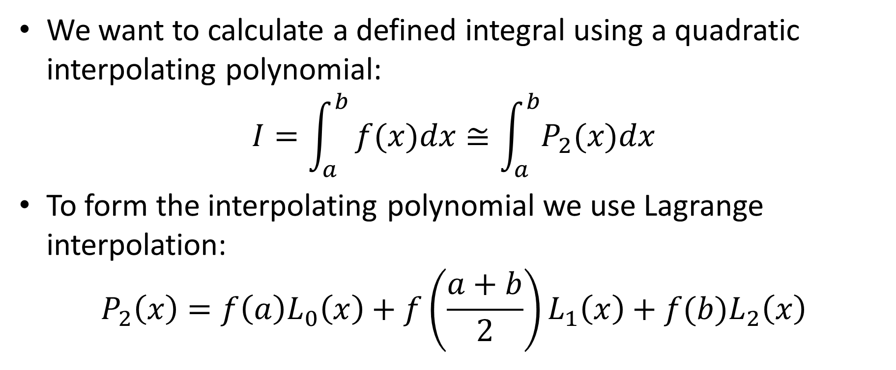
Derivation
We want to calculate a defined integral using a quadratic interpolating polynomial:
$$I=\int_{a}^{b}{f(x)dx≅\int_{a}^{b}{P_{2}(x)dx}}$$
To form the interpolating polynomial we use Lagrange interpolation:
$$P_{2}\left(x\right)=f\left(a\right)L_{0}\left(x\right)+f\left(\frac{a+b}{2}\right)L_{1}\left(x\right)+f(b)L_{2}\left(x\right)$$
Notes:
To find the approximation of our defined integral we integrate the interpolating polynomial P2(x)
For this we compute the interpolating polynomial P2(x) as a linear combination of three Lagrange polynomials Lo(x), L1(x) and L2(x)

Slide 4




Derivation
The Quadrature formula becomes
$$I=\int_{a}^{b}{f(x)dx≅}$$
$$f\left(a\right)\int_{a}^{b}{L_{0}\left(x\right)dx+f\left(\frac{a+b}{2}\right)\int_{a}^{b}{L_{1}\left(x\right)dx}+f\left(b\right)\int_{a}^{b}{L_{2}\left(x\right)dx}}$$
$$I≅f\left(a\right)c_{0}+f\left(\frac{a+b}{2}\right)c_{1}+f\left(b\right)c_{2}$$
$$c_{0}$$
$$c_{1}$$
$$c_{2}$$
Notes:
We proceed the same way as for the trapezoid rule
The quadrature formula becomes the sum of the three integrals over the Lagrange polynomials
Calling these integrals co, c1 and c2 we can write the quadrature formula as $f\left(a\right)c_{0}+f\left(\frac{a+b}{2}\right)c_{1}+f\left(b\right)c_{2}$

Slide 5
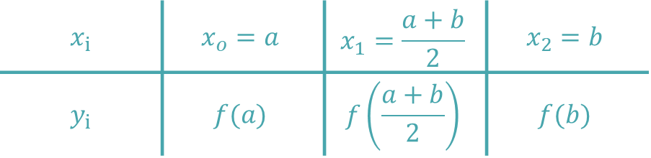
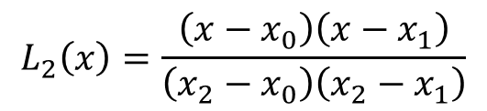
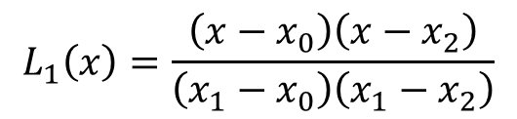
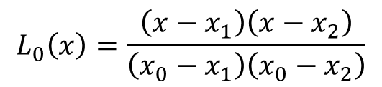
Lagrange Polynomials
The Lagrange polynomials are:
$$x_{i}$$ | $$x_{o}=a$$ | $$x_{1}=\frac{a+b}{2}$$ | $$x_{2}=b$$
$$y_{i}$$ | $$f(a)$$ | $$f\left(\frac{a+b}{2}\right)$$ | $$f(b)$$
$$L_{0}\left(x\right)=\frac{\left(x−x_{1}\right)\left(x−x_{2}\right)}{\left(x_{0}−x_{1}\right)\left(x_{0}−x_{2}\right)}$$
$$L_{1}\left(x\right)=\frac{\left(x−x_{0}\right)\left(x−x_{2}\right)}{\left(x_{1}−x_{0}\right)\left(x_{1}−x_{2}\right)}$$
$$L_{2}\left(x\right)=\frac{\left(x−x_{0}\right)\left(x−x_{1}\right)}{\left(x_{2}−x_{0}\right)\left(x_{2}−x_{1}\right)}$$
Notes:
Let us find the three Lagrange polynomials
For this let us write down a table with the two interpolating points
Based on this table it is simple to write down Lo, L1 and L2.
I invite you to try it by yourself

Slide 6
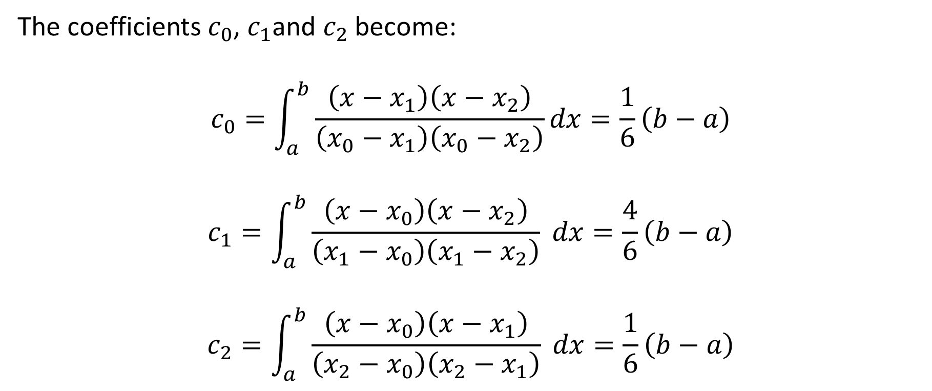
Quadrature Coefficients
The coefficients $c_{0}$, $c_{1}$and $c_{2}$ become:
$$c_{0}=\int_{a}^{b}{\frac{\left(x−x_{1}\right)\left(x−x_{2}\right)}{\left(x_{0}−x_{1}\right)\left(x_{0}−x_{2}\right)}dx=\frac{1}{6}}\left(b−a\right)$$
$$c_{1}=\int_{a}^{b}{\frac{\left(x−x_{0}\right)\left(x−x_{2}\right)}{\left(x_{1}−x_{0}\right)\left(x_{1}−x_{2}\right)} dx=\frac{4}{6}\left(b−a\right)}$$
$$c_{2}=\int_{a}^{b}{\frac{\left(x−x_{0}\right)\left(x−x_{1}\right)}{\left(x_{2}−x_{0}\right)\left(x_{2}−x_{1}\right)} dx=\frac{1}{6}\left(b−a\right)}$$
Notes:
As last step we have to integrate the three Lagrange polynomials
Being polynomials of degree two this task is simple
I invite you to perform these three integrations

Slide 7

Simpson 1/3-Rule
Putting all together
$$I≅f\left(a\right)c_{0}+f\left(\frac{a+b}{2}\right)c_{1}+f\left(b\right)c_{2}$$
$$I≅\frac{b−a}{6}\left[f\left(a\right)+4f\left(\frac{a+b}{2}\right)+f\left(b\right)\right]$$
Notes:
We can now put all together and after simplification we get the quadrature formula known the Simpson 1/3 rule

Slide 8





Simpson 1/3-Rule
Alternative formulation
$$I≅\frac{h}{3}\left[f\left(a\right)+4f\left(\frac{a+b}{2}\right)+f\left(b\right)\right]$$
with $h=\frac{b−a}{2}$
$$h=\frac{b−a}{2}$$
$$x_{1}=\frac{a+b}{2}$$
$$x_{0}=a$$
$$x_{2}=b$$
Notes:
As for the trapezoid rule there is an alternate formulation if one introduces h as the quantity $\frac{b−a}{2}$
Note that h is the distance between the interpolating points.
In this alternate formulation the name of the quadrature becomes clear. The 1/3 comes from the fact h is dived by 3 in front of the formula

Slide 9
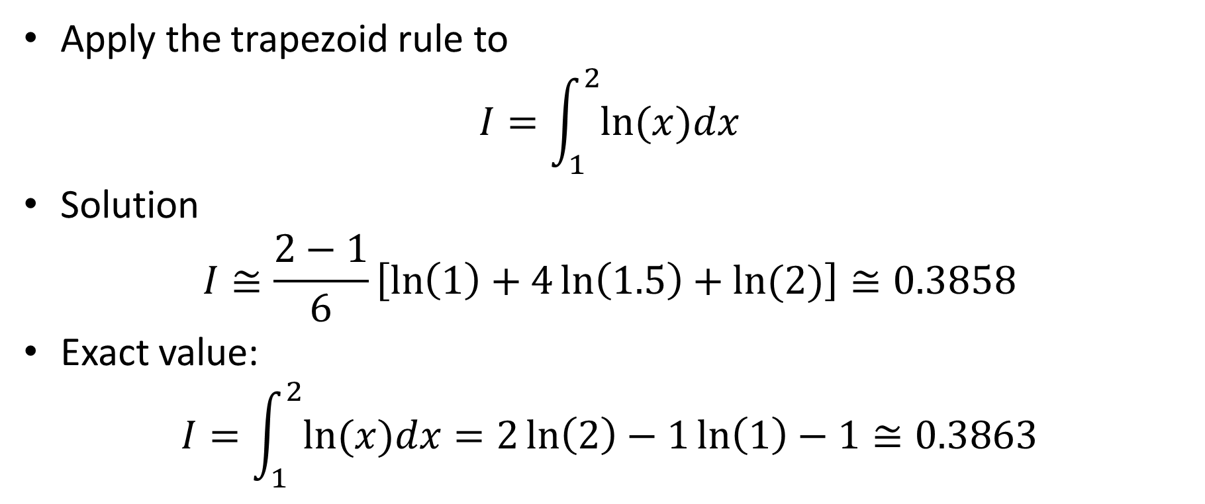
Example
Apply the trapezoid rule to
$$I=\int_{1}^{2}{ln⁡(x)dx}$$
Solution
$$I≅\frac{2−1}{6}\left[\ln\left(1\right)+4\ln\left(1.5\right)+ln⁡(2)\right]≅0.3858$$
Exact value:
$$I=\int_{1}^{2}{ln⁡(x)dx}=2\ln\left(2\right)−1\ln\left(1\right)−1≅0.3863$$
Notes:
Let us now apply our quadrature formula to an example
For this we compute the defined integral of the natural log function over the interval [1, 2]
Using the Simpson 1/3 rule we find 0.3858 if we keep four digits in our calculations
We can compare this approximation with the exact value 0.3863 we get by using calculus.
Note that both values are remarkably close.

Slide 10
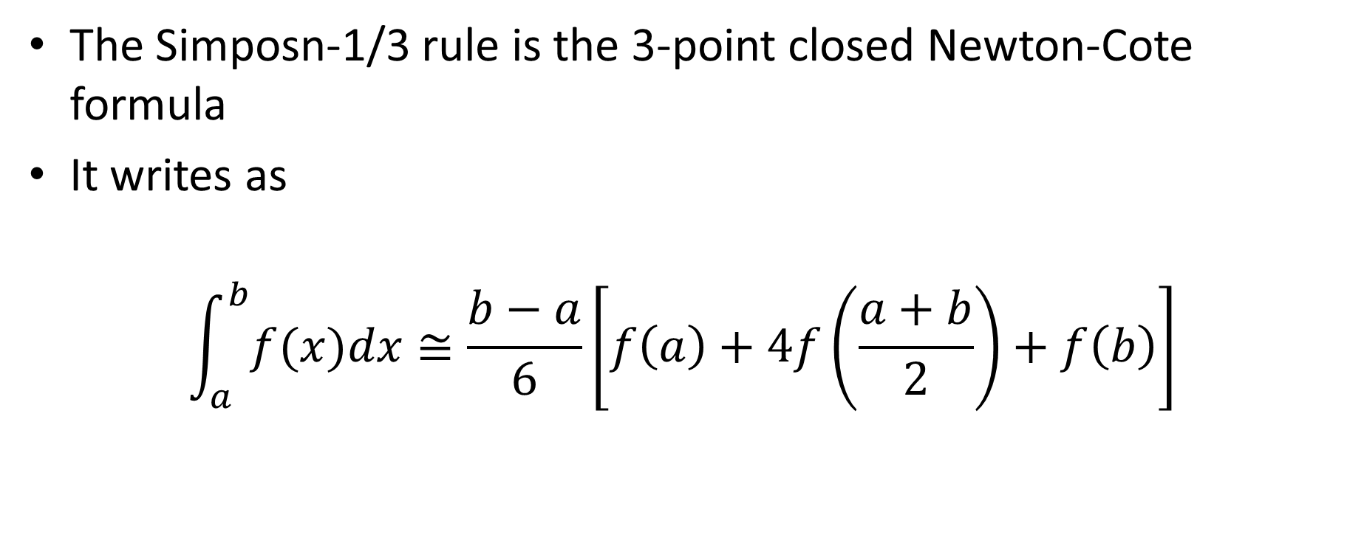
Summary
The Simposn-1/3 rule is the 3-point closed Newton-Cote formula
It writes as
$$\int_{a}^{b}{f(x)dx}≅\frac{b−a}{6}\left[f\left(a\right)+4f\left(\frac{a+b}{2}\right)+f\left(b\right)\right]$$
Notes:
Let us summarize the key findings
- The Simposn-1/3 rule is the 3-point closed Newton-Cote formula
- It writes as
$$\int_{a}^{b}{f(x)dx}≅\frac{b−a}{6}\left[f\left(a\right)+4f\left(\frac{a+b}{2}\right)+f\left(b\right)\right]$$

